Slide 1



To-Do List Application Presentation
Sandeep Prajapati
sandeepprajapati1202@gmail.com
9643609607
Final project – VOC VaultOfCode
\

Slide 2

CONTENTS
1. Project Title Slide
2. Introduction – What is a To-Do List?
3. Objective of the Project – Why we built it
4. Working – How the Application Works
5. System Design / Flow – Architecture & Features
6. Uses – Practical Applications
7. Advantages – Strengths of the Project
8. Disadvantages – Limitations
9. Future Scope – Improvements & Expansion Ideas
10. Conclusion – Key Takeaways
11. Q/A Slide – Any Questions?

Slide 3

01
Project Title Slide

Slide 4
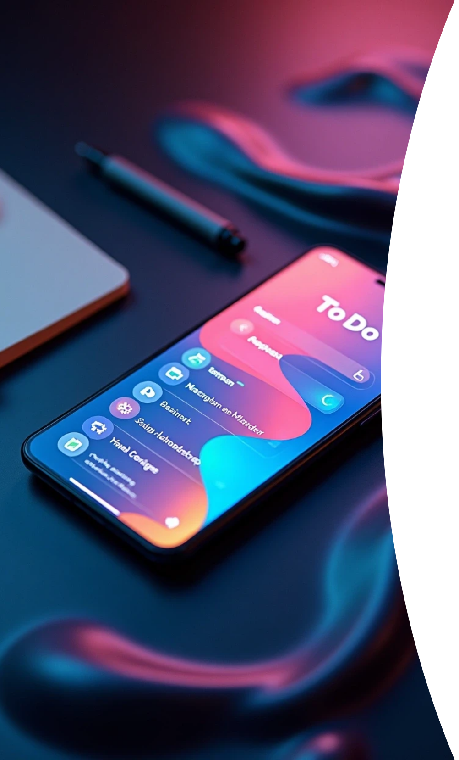


Slide Content
Project Title
Your Name
Course/Batch
Logo/Image of To-Do App

Slide 5
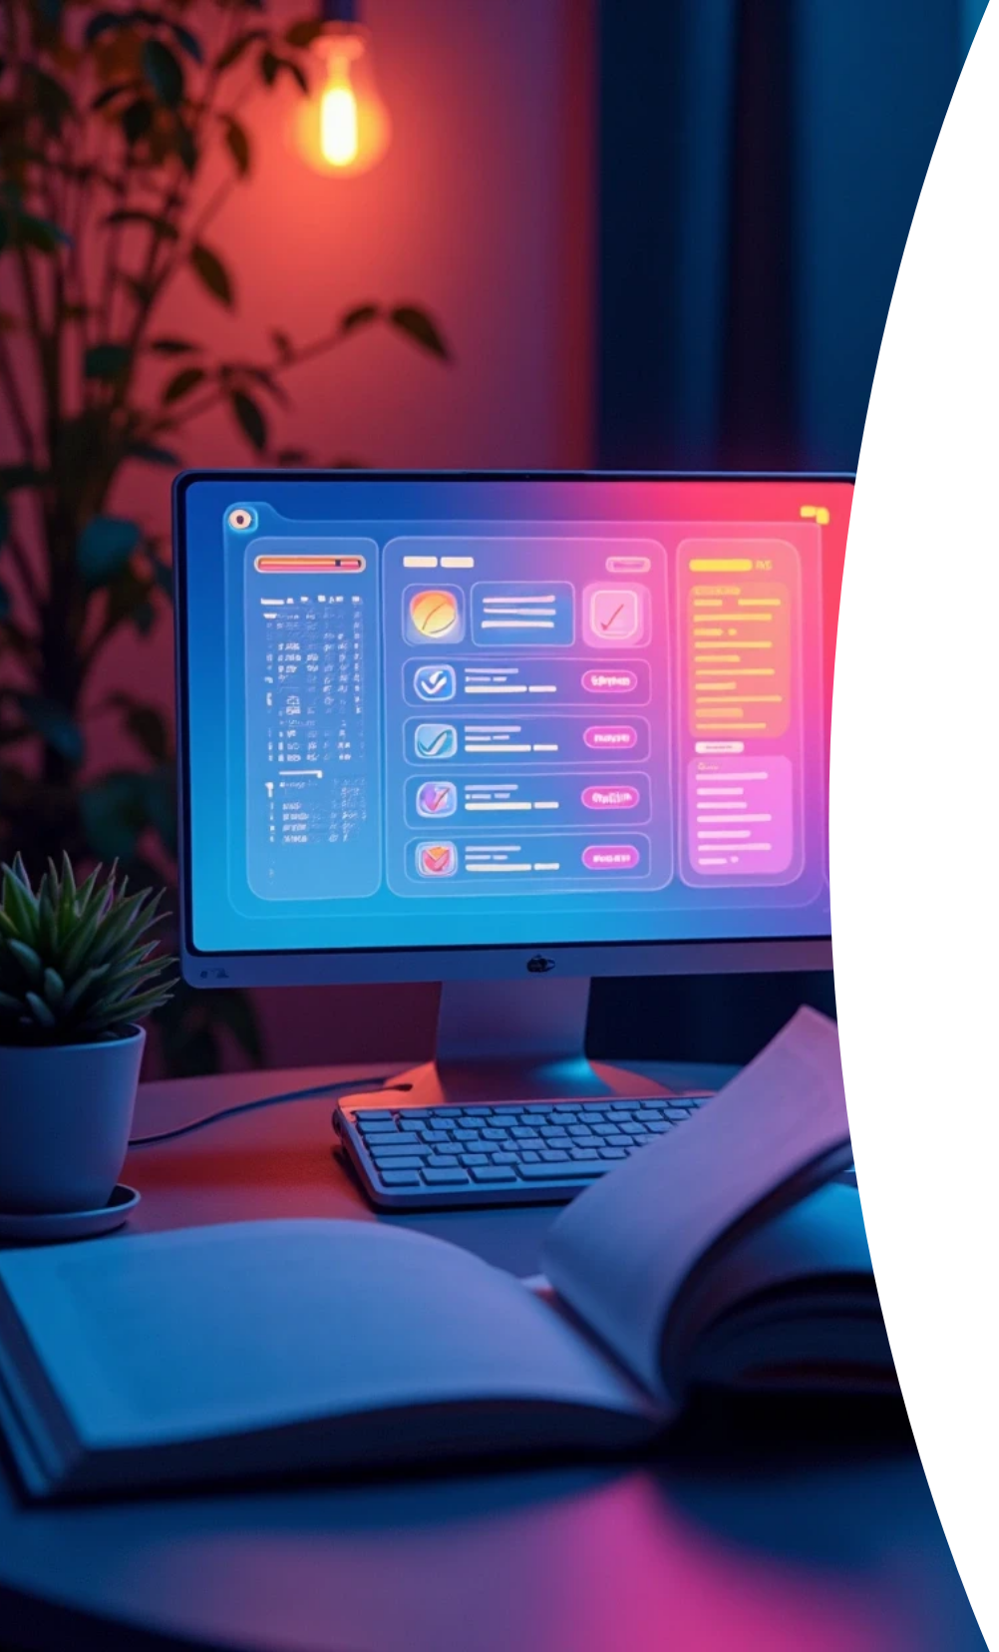
Explanation
“Good [morning/afternoon], today I’m presenting my project ‘To-Do List Application’, which is a task management system designed to help users manage and track daily activities effectively. This project focuses on productivity, simplicity, and scalability.”

Slide 6

02
Introduction – What is a To-Do List?

Slide 7



Slide Content
1
Definition
2
Importance

Slide 8

Explanation
“A To-Do List is a productivity tool where users list tasks they want to accomplish. It’s widely used by students, professionals, and organizations. The importance lies in better time management, reducing stress, and improving focus by breaking work into smaller manageable steps.”

Slide 9
03
Objective of the Project – Why we built it

Slide 10

Slide Content
Goals of project

Slide 11
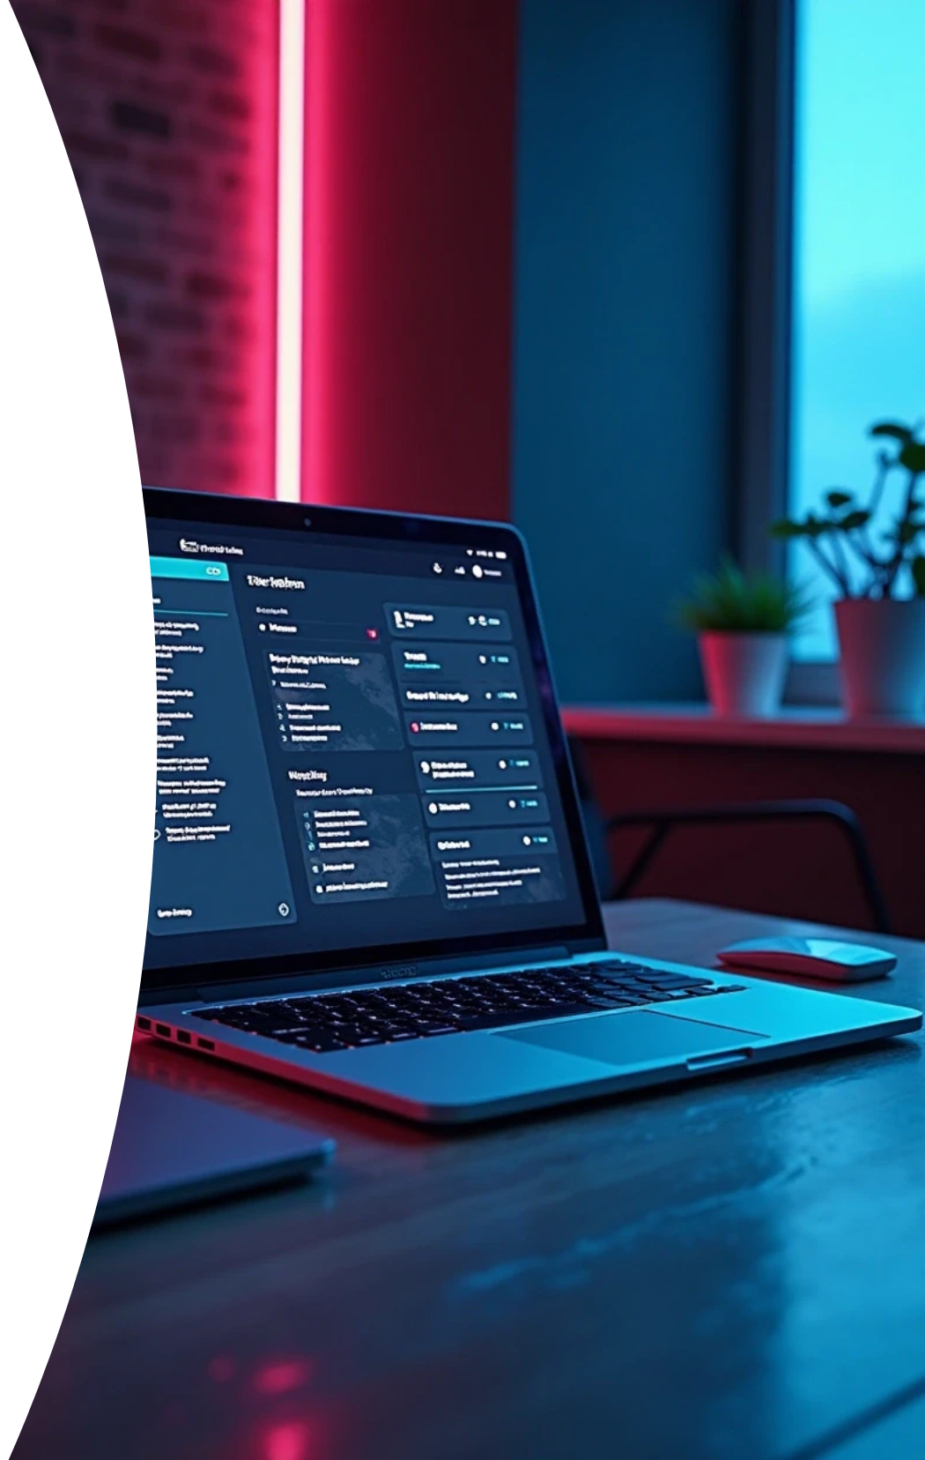
Explanation
“The main objective of this project is to build a lightweight yet powerful tool that helps users organize their work, set priorities, and track completion. Unlike traditional pen-paper lists, our system is digital, interactive, and future-ready for advanced integrations.”

Slide 12
04
Working – How the Application Works

Slide 13



Slide Content
1
Add
2
Edit
3
Delete
4
Mark Complete

Slide 14

Explanation
“The working is simple and intuitive: a user can add tasks, edit them, delete if unnecessary, and mark them as complete once finished. The interface updates in real-time, giving users a clear overview of pending vs completed tasks. Depending on implementation, tasks can also be stored locally or in a cloud database.”

Slide 15
05
System Design / Flow – Architecture & Features

Slide 16
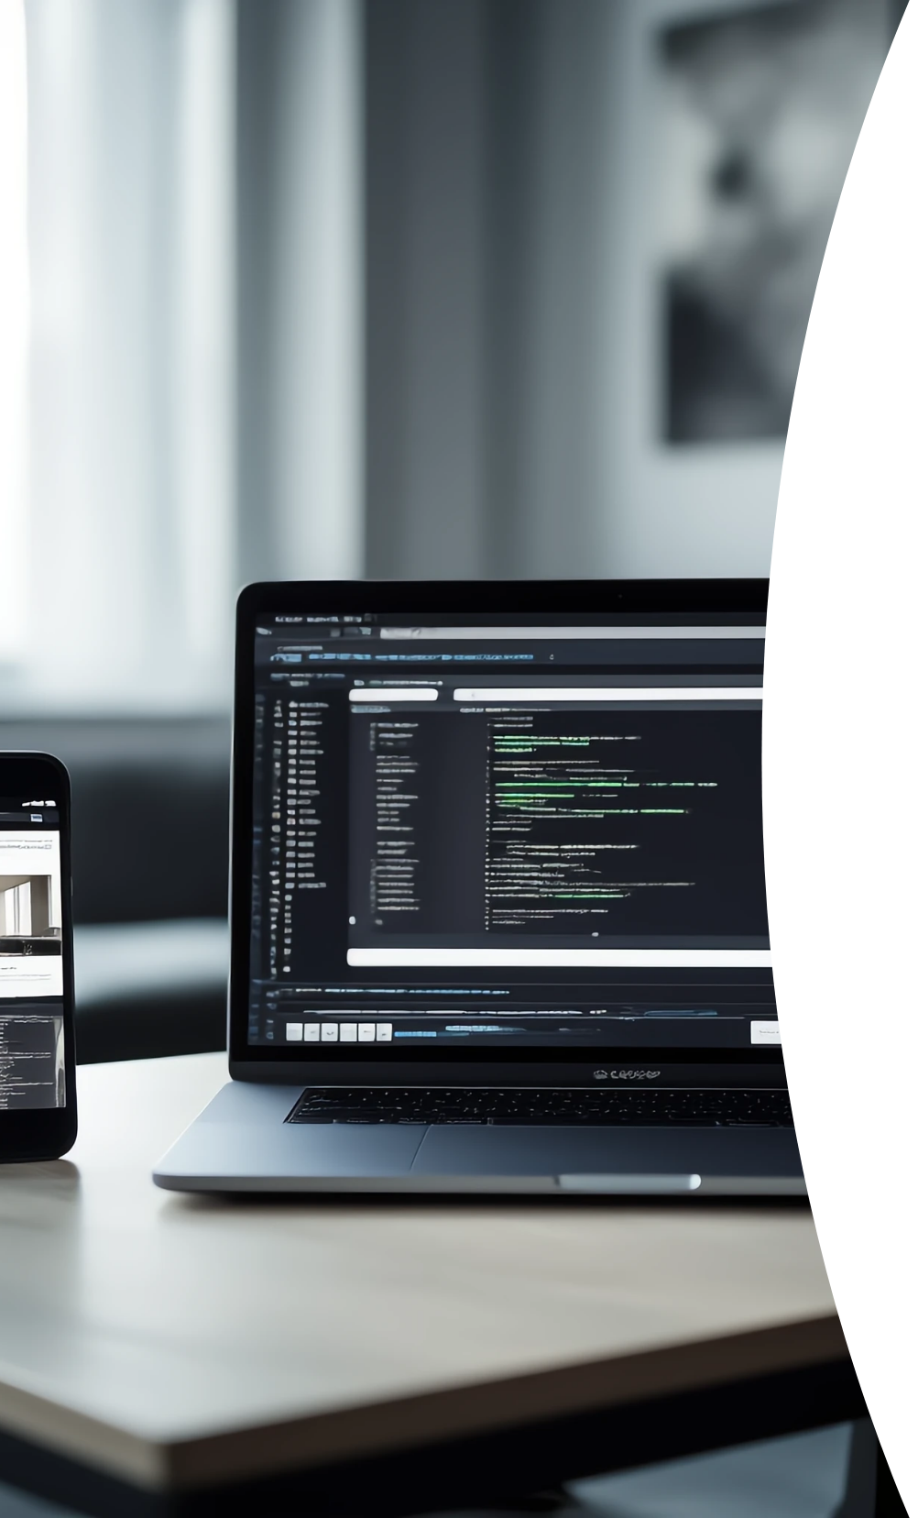
Slide Content
Frontend
Backend
Database flow

Slide 17

Explanation
“Our project follows a client-server model. The frontend (built with HTML, CSS, JS or React) provides user interaction. The backend (Node.js, Django, or Flask) handles data operations. Tasks are stored in a database (MySQL, MongoDB, or local storage). Key features include task categorization, deadlines, and responsive design for mobile/desktop use.”

Slide 18
06
Uses – Practical Applications

Slide 19

Slide Content
1
Personal uses
2
Professional uses

Slide 20

Explanation
“This application has wide practical uses. For students, it helps in managing assignments, study plans, or exam preparation. For professionals, it helps in managing work deadlines, meetings, and projects. Even in daily life, it can be used for shopping lists, reminders, and goal-setting.”

Slide 21
07
Advantages – Strengths of the Project

Slide 22

Slide Content
Productivity boost
Accessibility

Slide 23

Explanation
“The To-Do List app provides several benefits. It boosts productivity by keeping tasks organized, ensures users don’t forget important deadlines, and reduces mental load. It is also easily accessible across devices, making it useful anytime, anywhere.”

Slide 24
08
Disadvantages – Limitations

Slide 25

Slide Content
1
Internet dependency
2
Basic automation

Slide 26

Explanation
“However, every system has limitations. If the app is cloud-based, it depends on internet connectivity. Also, without AI features, it cannot auto-prioritize or suggest tasks. Additionally, some users may feel digital dependency, preferring traditional methods.”

Slide 27
09
Future Scope – Improvements & Expansion Ideas

Slide 28

Slide Content
AI
Voice
Sync

Slide 29

Explanation
“The future scope is exciting. We can integrate AI to suggest task priorities, detect deadlines, or auto-generate schedules. Features like voice-enabled commands, synchronization across devices, and integration with calendars (like Google Calendar, Outlook) can make it a complete personal productivity assistant.”

Slide 30
10
Conclusion – Key Takeaways

Slide 31

Slide Content
Summary points

Slide 32

Explanation
“In conclusion, the To-Do List project is more than just a digital checklist—it’s a productivity partner that can evolve into a smart task manager with future enhancements. It’s simple, user-friendly, and holds potential to scale into advanced AI-powered tools.”

Slide 33
11
Q/A Slide – Any Questions?

Slide 34

Slide Content
“Thank You”
“Any Questions?”

Slide 35

Explanation
“This concludes my presentation on the To-Do List project. Thank you for your attention, and now I would be happy to take your questions.”

Slide 36
Thank You

